Slide 1
Lawn Buddy
“The cutting hedge technology”
Final Venture Concept Pitch
Gasser Ahmed
MGT 5824
8/4/2023

Slide 2






Venture Concept
Convenient and Efficient Scheduling
Time-Saving Automation
Tailored Personalization
Reliable Skilled Professionals
Real-Time Updates and Engagement
Lawn Buddy's cutting-edge AI technology revolutionizes lawn mowing scheduling. By analyzing lawn size, grass growth patterns, and local weather conditions, our algorithms ensure optimal mowing schedules, guaranteeing efficient and timely service without hassle.
Our platform automates lawn care, freeing customers from manual effort. AI-guided scheduling and skilled professionals mean homeowners can enjoy a perfectly mowed lawn without investing their precious time, allowing them to focus on what truly matters.
Lawn Buddy offers a new level of personalization. We create custom lawn care plans by considering unique characteristics like size, location, and specific needs. This approach guarantees that every lawn receives the individualized attention it deserves.
Trust is paramount, which is why we've built a network of proficient lawn mowing professionals. With their expertise, customers can rest assured that their lawns are in reliable care, fostering a sense of confidence and satisfaction.
Lawn Buddy stands out with real-time updates and notifications. From service provider progress alerts to task completion notifications, our transparent communication ensures customers are well-informed and engaged throughout the process.
In summary, Lawn Buddy's venture concept is centered around offering a convenient, efficient, and personalized lawn care experience. Through AI-driven scheduling, time-saving automation, tailored care plans, reliable professionals, and real-time updates, we are reshaping the way homeowners enjoy the beauty of their outdoor spaces.

Slide 3






Target Customer Segment: Customer Persona 1
Background
Demographics
Jamila is a 50-year-old homeowner who takes pride in her well-maintained lawn. She works a demanding job and values her free time on weekends. She's tech-savvy and uses her smartphone for various tasks. However, the time-consuming nature of lawn care has become a challenge for her.
Age: 50
Occupation: Marketing Manager
Household: Married with two teenagers
Location: Suburban neighborhood
Jamila
Middle-Aged Homeowner
Goals and Needs
Pain Points
How Lawn Buddy Helps
Maintain a beautiful lawn to enhance curb appeal.
Free up time on weekends for family and leisure activities.
Hassle-free scheduling and reliable lawn care service.
Limited time for lawn care due to work and family commitments.
Difficulty finding trustworthy and skilled lawn care professionals.
Lack of control over lawn care scheduling.
AI-powered scheduling ensures her lawn is maintained without manual intervention.
Personalized care plans consider her lawn's unique needs.
Real-time updates and notifications keep her informed about the service progress.
Easy payment and cashless transactions streamline the process.

Slide 4

Target Customer Segment: Customer Persona 2
Background
Demographics
Bilal is a 40-year-old property manager responsible for maintaining the grounds of a busy commercial office complex. They oversee multiple properties and need a reliable solution to keep the lawns well-manicured. Efficiency and cost-effectiveness are top priorities.
Age: 40
Occupation: Property Manager
Company: Commercial property management firm
Location: Urban area
Bilal
Commercial Property Manager
Goals and Needs
Pain Points
How Lawn Buddy Helps
Ensure the outdoor spaces of commercial properties are well-maintained.
Optimize operational efficiency and reduce landscaping costs.
Access to a trusted and skilled team of lawn care professionals.
Balancing multiple properties and maintenance tasks.
Managing landscaping budgets while ensuring quality.
Difficulty coordinating schedules and tracking service progress.
AI-powered scheduling automates lawn care planning across various properties.
Reliable service providers consistently deliver high-quality results.
Real-time updates and notifications provide visibility into service execution.
Cost-effective solutions and competitive pricing fit within budget constraints.
Notes:
These customer personas highlight the diverse needs and pain points of two distinct segments targeted by Lawn Buddy. By addressing the specific goals and challenges of middle-aged homeowners and commercial property managers, Lawn Buddy can tailor its value propositions to provide maximum value and convenience to each customer group.

Slide 5



Key Customer Problems
Pains
Gains
Jobs to Be Done
Time Constraints: Busy individuals lack the time for regular lawn care due to work and personal commitments.
Expertise Gap: Many lack the knowledge and skills needed for effective lawn maintenance.
Reliability Concerns: Finding trustworthy and skilled lawn care providers poses a challenge.
Scheduling Hassles: Coordinating and scheduling lawn care services manually is inconvenient and time-consuming.
Time-Saving: Customers seek solutions that free up their time by automating lawn care.
Expertise and Convenience: Access to professional lawn care expertise without personal involvement.
Reliability: Consistent and reliable lawn care services without worries about provider quality.
Control and Peace of Mind: Control over scheduling, notifications, and updates for a stress-free experience.
Efficient Lawn Care: Achieve a well-maintained lawn without investing personal time and effort.
Trusted Care: Ensure professional lawn care even without direct oversight.
Convenient Scheduling: Easily schedule and manage lawn care services based on individual preferences.
Stay Informed: Receive real-time updates and notifications about service progress.
Notes:
By understanding and addressing these customer problems, Lawn Buddy can create a tailored solution that truly resonates with its target customers, whether they are middle-aged homeowners or commercial property managers.

Slide 6
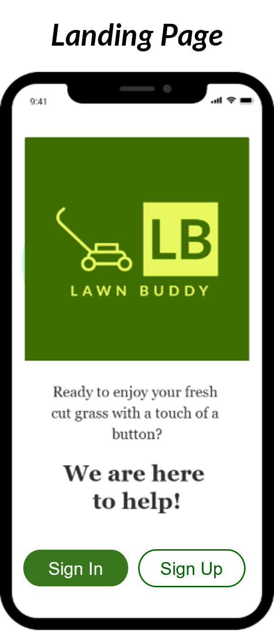
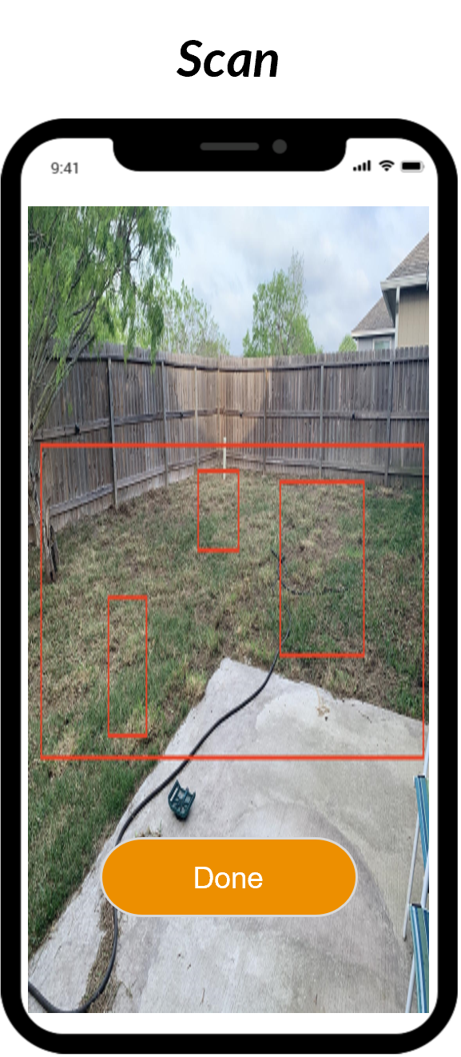
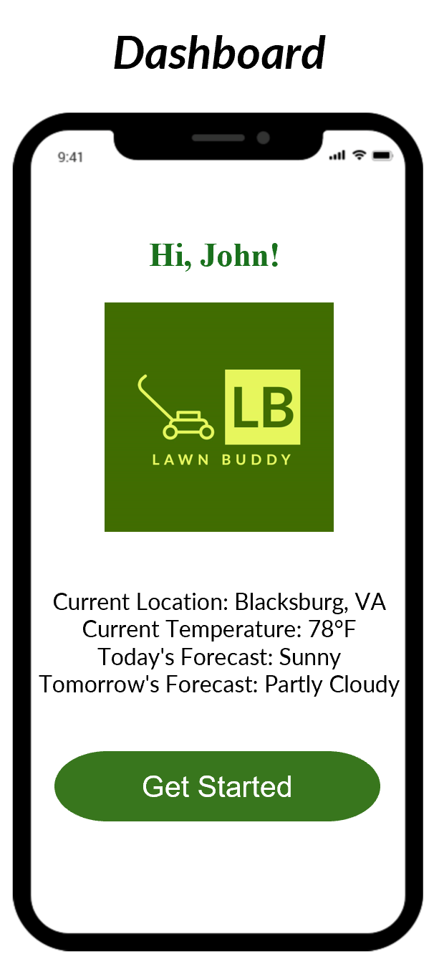
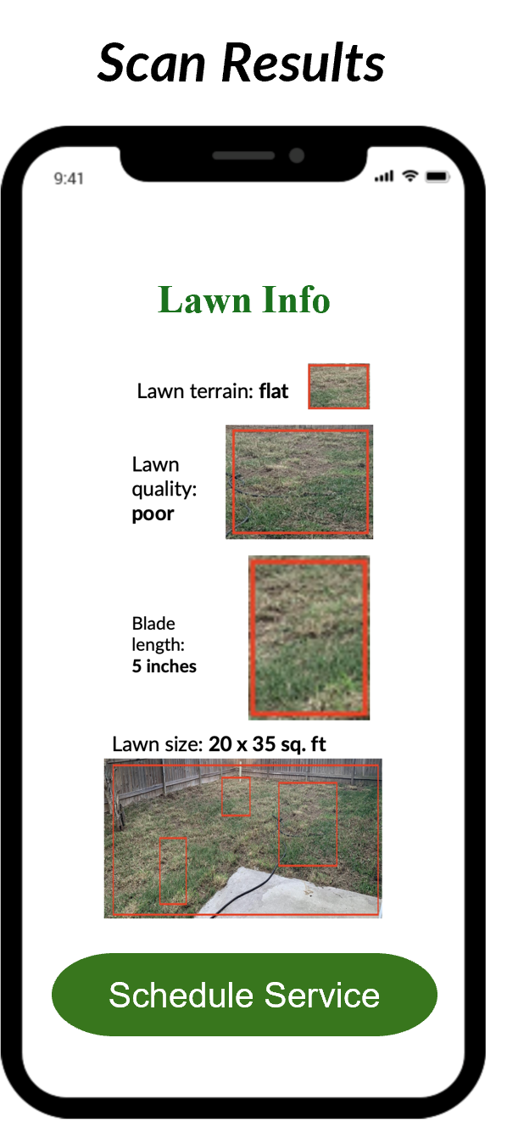
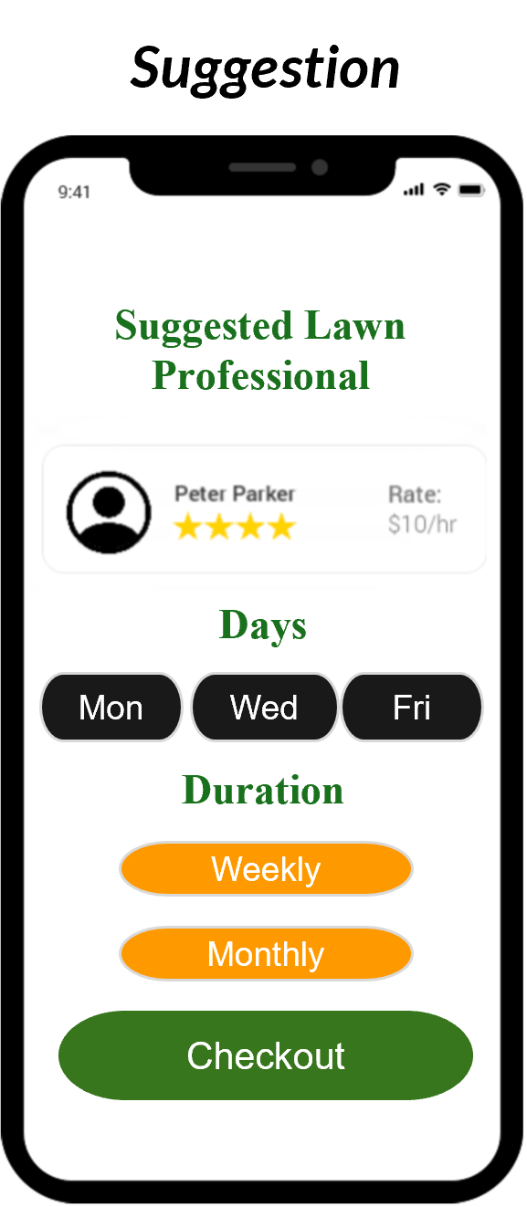
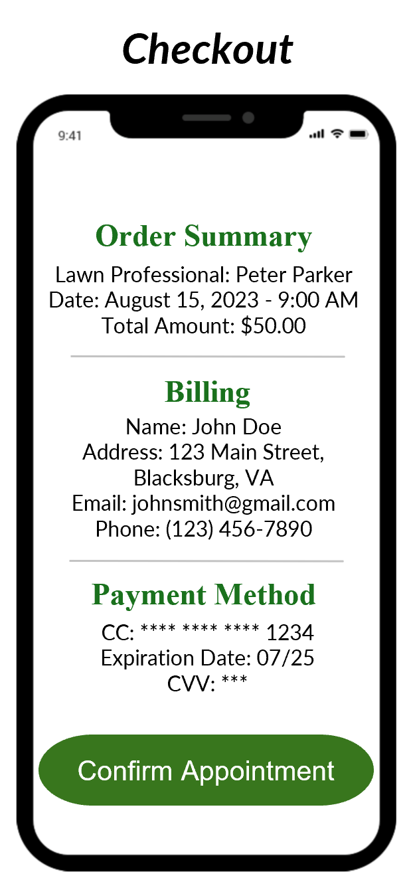
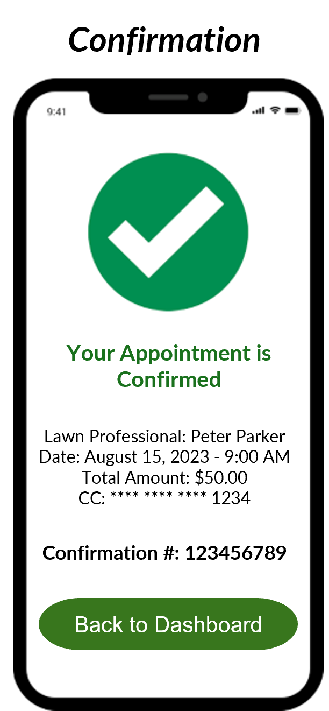
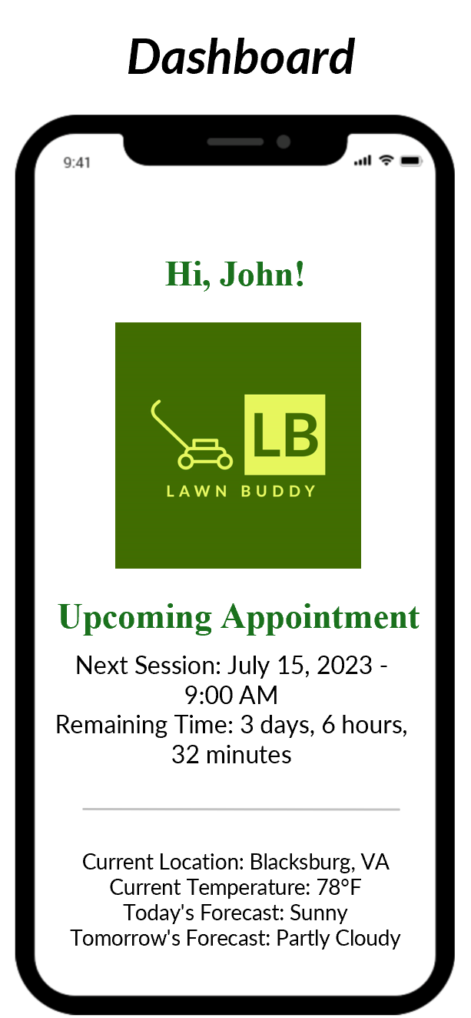
Proposed Solution – MVP
AI-Powered Scheduling: Our cutting-edge AI algorithms take into account your lawn's exact measurements, grass type, growth patterns, and local weather conditions. This ensures that the mowing schedule is perfectly optimized for maintaining a healthy and beautiful lawn.
User-Specific Object Recognition: Using advanced object recognition technology, the app scans your lawn's unique characteristics, such as patches, obstacles, and specific care requirements. This data informs a personalized care plan tailored precisely to your lawn's needs.
Trusted Service Providers: Our network features thoroughly vetted and experienced lawn care professionals. Each provider undergoes a rigorous selection process, ensuring you receive top-quality service that meets our high standards.
Real-Time Updates: Receive instant notifications when a service provider is en route, has started the mowing session, and when the job is completed. Real-time GPS tracking allows you to monitor progress and anticipate service completion.
Secure Payments: Lawn Buddy offers secure, cashless payment options directly through the app. Easily review and approve charges, making transactions convenient and hassle-free.
User Profiles: Create and manage your user profile to customize preferences, set mowing schedules, and view a comprehensive history of past services. Adjust your plan as your lawn's needs change over time.
1.
2.
3.
4.
1.
5.
6.
7.
8.

Slide 7
Problem-Solution Fit & Market Validation
Growing Market Demand
Target Demographic Validation - Age Group:
Primary Customer Segment - Single-Family Residential
Challenges & Pain Points Confirmed
Market Growth: The lawn mowing market has consistently expanded, growing from 83.25 billion in 2013 to a substantial 176 billion in 2023. This growth trend indicates sustained demand for lawn care services.
Rapid Expansion: The acceleration of market growth from 119 billion in 2018 to 176 billion in 2023 showcases a surge in demand over recent years. This period of rapid expansion underscores the increasing need for efficient lawn maintenance solutions.
Dominant Age Group: The age group of 50-64 years represents the largest share of respondents at 32.09%. This demographic alignment confirms that middle-aged and older individuals are actively engaged in and interested in lawn mowing activities.
Prime Working Years: The 30-49 years age group, accounting for 22.58% of respondents, indicates that individuals in their prime working years also have a significant presence in the lawn mowing market.
Largest Customer Segment: Single-family residential customers constitute the majority, representing 59% of the total customer base. This statistic highlights homeowners' significant demand for lawn care services.
Commercial and Other Segments: Commercial properties (24%), multi-family residential (11%), and governmental (5%) segments also contribute to the customer base, showing a diverse but central focus on single-family residential customers.
Physical Challenges: Customer feedback consistently highlights physical challenges, including limited mobility, arthritis, and back injuries. This confirms that Lawn Buddy's emphasis on reducing physical effort through AI-powered solutions is well-aligned with customer needs.
Time Consumption and Obstacles: Interviews reveal time-consuming aspects of lawn care, especially maneuvering around obstacles and dealing with post-mowing tasks. Lawn Buddy's optimization of scheduling and obstacle detection directly addresses these concerns.
Health Limitations & Accessibility
Desired Features Aligned
Affordability and Pricing Sensitivity
Strong Problem-Solution Fit
Health-Related Limitations: The data highlights health conditions such as respiratory issues, vision problems, and chronic fatigue affecting the ability to mow efficiently. Lawn Buddy's personalized care plans and adaptability cater to individuals with diverse health-related limitations.
Accessibility Enhancement: By providing remote monitoring and adaptable features, Lawn Buddy ensures that those with physical limitations can easily access and manage their lawn care.
Automatic Obstacle Detection: Respondents' desire for automatic obstacle detection and avoidance resonates with Lawn Buddy's AI-powered obstacle recognition technology.
Weather-Based Scheduling: The emphasis on weather-based scheduling aligns with Lawn Buddy's intention to optimize schedules based on local weather conditions.
Real-Time Updates: The need for real-time updates and notifications corresponds to Lawn Buddy's commitment to keeping users informed about service progress.
Transparent Pricing: Customers' preference for transparent pricing without hidden costs aligns with Lawn Buddy's commitment to straightforward and accessible pricing models.
Flexibility: The desire for flexible payment plans and rental options matches Lawn Buddy's consideration of diverse pricing structures to cater to different user needs.
Solution Relevance: The identified customer problems and desired features closely mirror Lawn Buddy's proposed AI-powered solution, demonstrating a strong alignment between market needs and the platform's capabilities.
Customer-Centric Approach: The comprehensive understanding of customer pain points and preferences strengthens Lawn Buddy's problem-solution fit, ensuring a solution that truly addresses the challenges faced by homeowners and property managers.

Slide 8
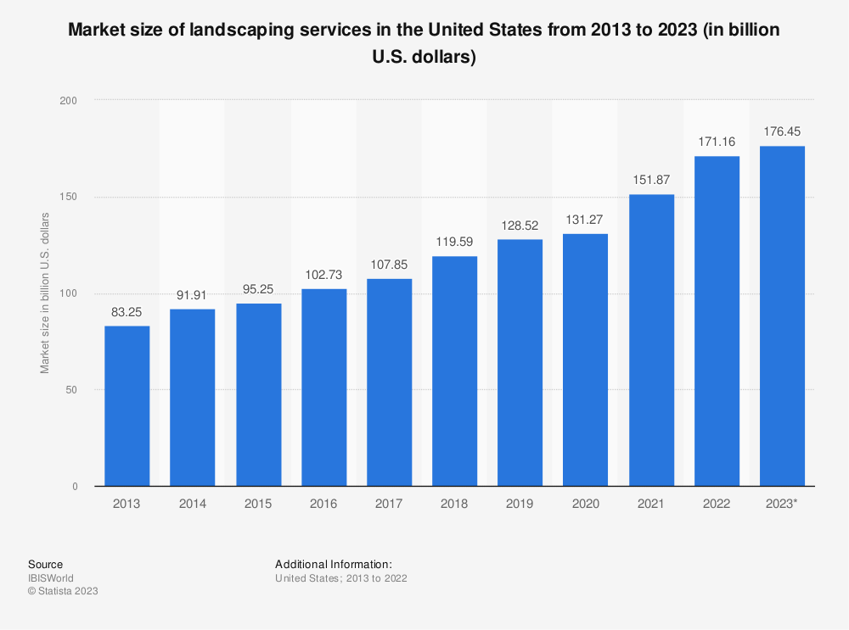
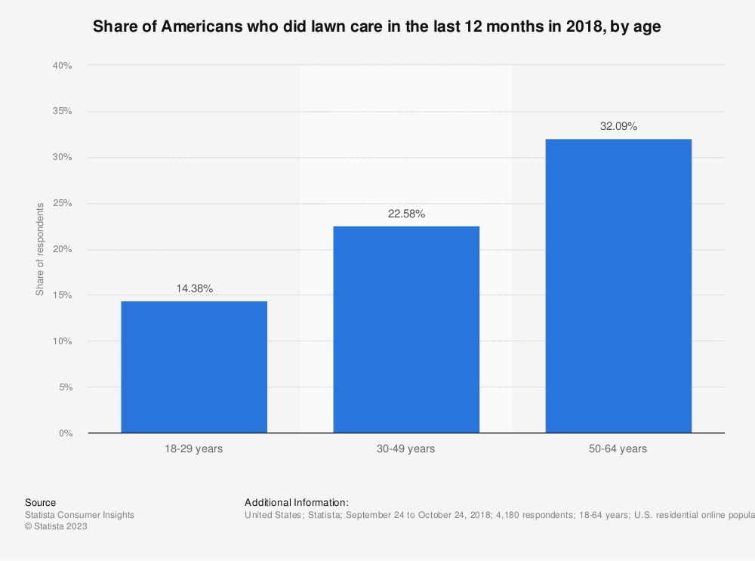
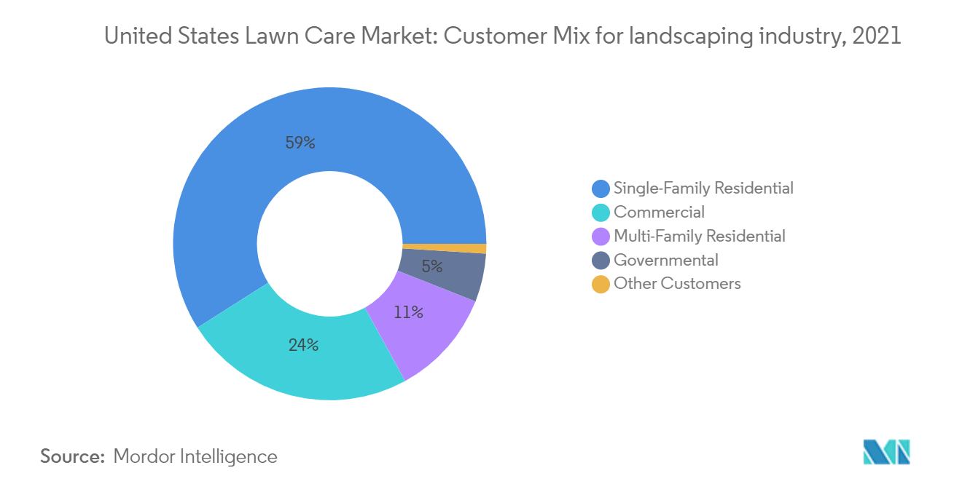
Market Size
Total Addressable Market (TAM)
Segment Targeting
Total Customer Demand
The total addressable market for Lawn Buddy encompasses all potential transactions within the lawn mowing industry, assuming complete market penetration. Lawn Buddy's focus aligns with a lawn mowing market that has demonstrated consistent growth. With market size figures indicating an expansion from 83.25 billion in 2013 to an impressive 176 billion in 2023, this trajectory underscores sustained demand.
Lawn Buddy's primary target is the middle-aged and older demographic, particularly those aged 50-64 years, which accounts for 32.09% of respondents. This group stands out as the most engaged or interested in lawn mowing activities, forming a substantial portion of the market.
TAM * % of Target Demographic = $176 billion * 32.09% = $56.5 billion.
Since we are specifically targeting middle-aged and older individuals in single-family residential areas (59%), the total customer demand within this segment is estimated as follows:
Customer Demand = Segment Size * % of Single-Family Residential Customers
Customer Demand = $56.5 billion * 59% = $33.335 billion.
Revenue Model
Commission-Based: Lawn Buddy's revenue model entails charging a percentage (10%) of every transaction made through the app for lawn mowing services. This revenue is directly proportional to the volume of successful transactions facilitated by the platform. ($700,000/month)
Subscription Model: Lawn Buddy offers premium subscription plans entailing extra features for a recurring monthly or yearly fee. This model ensures a steady and predictable revenue stream from subscribers seeking enhanced offerings beyond the basic service. ($20,000/month)
Advertisements: Lawn Buddy leverages advertisements to generate revenue by enabling local lawn care businesses and related companies to advertise within the app. This strategy establishes an additional income stream by capitalizing on collaborations with businesses keen on reaching Lawn Buddy's user base. ($30,000/month)

Slide 9


Competitive Advantage & Value Proposition
Competitive Advantage
Value Proposition
AI-Driven Precision and Efficiency: Our advanced AI technology sets us apart by revolutionizing the scheduling process. Lawn Buddy's algorithms analyze diverse parameters such as lawn size, grass growth patterns, and local weather conditions. This unparalleled precision ensures optimal mowing schedules, resulting in efficient and timely service.
Streamlined Automation: By automating lawn care through AI-guided scheduling and skilled professionals, we create a seamless experience. This streamlined approach not only ensures precise and punctual mowing but also liberates our customers from the arduous task, allowing them to invest their time in more meaningful pursuits.
Tailored Perfection: Lawn Buddy redefines personalization by crafting lawn care plans tailored to each lawn's unique characteristics. The customization extends to factors like size, location, and specific needs, guaranteeing that every lawn receives the individualized attention it deserves.
Dependable Expertise: Our handpicked network of proficient lawn mowing professionals brings a wealth of expertise to every task. This trust in skilled hands reassures our customers that their lawns are in reliable care, fostering a sense of confidence and satisfaction.
Transparent Real-Time Communication: Lawn Buddy stands out through real-time updates and notifications. From service provider progress alerts to task completion notifications, our transparent communication ensures that our customers are always informed and engaged in the process.
Effortless Efficiency: Powered by AI and object recognition technology, Lawn Buddy ensures effortless lawn maintenance. Say goodbye to manual effort – our platform identifies obstacles and optimizes mowing patterns for a flawless finish.
Time Reclaimed: Our automation not only ensures a perfectly mowed lawn but also gives customers the luxury of time. Spend more moments doing what you love, knowing your lawn is in capable hands.
Your Lawn, Your Plan: Lawn Buddy's personalized care plans guarantee that your lawn's unique needs are met. Whether it's a small backyard or an expansive estate, we tailor our approach to deliver the perfect care.
Trusted Care: With Lawn Buddy, you're entrusting your lawn to skilled professionals who are committed to excellence. Experience peace of mind knowing that your outdoor space is cared for by dependable experts.
Stay Connected: Our real-time updates keep you informed throughout the process, ensuring transparency and fostering a sense of partnership. Enjoy a sense of control and engagement as your lawn transforms.
In essence, Lawn Buddy's competitive advantage lies in its seamless blend of cutting-edge AI technology, object recognition, and personalized care plans, all of which are encapsulated in a compelling value proposition. This synergy positions Lawn Buddy as a trailblazer in the lawn care industry, redefining how homeowners experience and enjoy the beauty of their outdoor spaces.

Slide 10








Business Model Overview
Key Partners
Key Activities
Key Resources
Lawn care service providers (individual contractors or companies)
GPS and mapping services for location tracking
Payment gateway providers
AI and data analytics companies for AI technology integration
Marketing and advertising partners for promoting the app
App development and maintenance
Partnering with lawn care service providers
Integrating AI algorithms for scheduling and route optimization
Customer support and relationship management
Continuous improvement of the AI algorithms and app features
Marketing and promotion of the app
Skilled app developers and designers
AI experts and data scientists
Server infrastructure for data storage and processing
Partnership agreements with lawn care service providers
Marketing and promotional resources
Customer support team
Customer Relationships
Channels
Customer Segments
User-friendly app interface for easy scheduling and communication
Prompt customer support through in-app chat, email, or phone
Regular updates and improvements based on customer feedback
Personalization of lawn care plans to meet individual customer needs
Mobile app stores (e.g., Apple App Store, Google Play Store)
Website for app promotion and customer onboarding
Social media platforms for marketing and advertising
Collaborations with hardware stores or gardening centers
Middle-aged and older residential homeowners with lawns/gardens
Commercial properties with lawns/gardens (e.g., offices, hotels, schools, parks)
Value Proposition
Revenue Model
Cost Structure
Convenient and efficient lawn mowing scheduling using AI technology
Time-saving for customers by automating lawn care services
Personalized lawn care plans based on lawn size, location, and specific needs
Reliable and skilled lawn mowing service providers
Real-time updates and notifications for customers
Commission-based: Charge a percentage of each lawn mowing service payment made through the app.
Subscription model: Offer premium plans with additional features for a monthly or yearly fee.
Advertisements: Allow local lawn care businesses or related companies to advertise within the app.
App development and maintenance costs
AI integration and data analytics expenses
Marketing and advertising costs
Customer support and relationship management expenses
Server hosting and maintenance fees
Operational costs associated with running the platform

Slide 11
Unit Economics & Scalability
Economics
Scalability
Lawn Buddy Income Statement - June 2023 | June 2023
Revenue:
Commissions from Mowing Services | $700,000
Subscription Fees | $20,000
Advertising Revenue | $30,000
Total Monthly Revenue | $750,000
Cost of Goods Sold (COGS):
Service Provider Payments | $550,000
Platform Maintenance and Hosting | $25,000
Customer Support | $15,000
Total Cost of Goods Sold (COGS) | $590,000
Gross Margin | 21.33%
Current Assets – June 2023
Cash and Cash Equivalents | $80,000
Accounts Receivable | $40,000
Total Current Assets: | $120,000
Current Liabilities
Accounts Payable | $20,000
Accrued Expenses | $10,000
Total Current Liabilities: | $30,000
Working Capital | $90,000
1. Solid Financial Foundation: Lawn Buddy's current assets of $120,000, comprising cash, cash equivalents, and accounts receivable, provide a substantial financial base. This foundation enables the company to invest in technology upgrades, customer acquisition, and operational enhancements essential for scaling the business.
2. Diverse and Stable Revenue Streams: Lawn Buddy's revenue model, fueled by commissions from mowing services, subscription fees, and advertising revenue, generates a total monthly revenue of $750,000. This diversified approach ensures consistent cash flow, enabling the company to weather market fluctuations while investing in growth initiatives.
3. Efficient Cost Structure: With a keen focus on cost management, Lawn Buddy achieves a competitive gross margin of 21.33%. By optimizing service provider payments, platform maintenance, and other operational expenses, the company maximizes profitability while maintaining service quality as it expands its operations.
4. Strategic Allocation of Startup Investments: Lawn Buddy's initial startup funds of $300,000, a combination of equity investment and a bank loan, are strategically distributed to drive growth. Investments in marketing and advertising, research and development, and general administrative expenses ensure a balanced approach to establishing and expanding its operations.
5. Growing Operating Performance: Lawn Buddy's operating income of $60,000, reflecting an operating margin of 8%, demonstrates the company's ability to generate profits while delivering value to its customers. As the customer base expands and operational efficiencies improve, these margins are expected to further strengthen, supporting sustainable growth.
6. Available Net Startup Funds for Agility: With net startup funds totaling $230,000, Lawn Buddy possesses a financial cushion to adapt to market dynamics and seize growth opportunities. These funds can be utilized to expand geographically, invest in customer acquisition strategies, and develop new features, ensuring the company remains agile and responsive to market demands.
Startup Funds – June 2023
Equity Investment | $200,000
Bank Loan | $100,000
Total Startup Funds | $300,000
Startup Costs
Initial Marketing and Advertising | $20,000
Product Research and Development | $15,000
Legal and Registration Expenses | $10,000
Employee Training and Onboarding | $5,000
Technology Infrastructure | $20,000
Total Startup Costs: | $70,000
Net Startup Funds | $230,000
Marketing and Advertising | $40,000
Research and Development | $25,000
General and Administrative | $35,000
Total Operating Expenses | $100,000
Operating Income | $60,000
Operating Margin | 8%
Notes:
In summary, Lawn Buddy's scalability is underpinned by a robust financial foundation, diverse revenue streams, efficient cost management, strategic allocation of startup investments, growing operating performance, and available net startup funds. With a comprehensive approach to scaling, Lawn Buddy is positioned to capitalize on the expanding lawn care market, driving continuous innovation, geographic expansion, and enhanced customer experiences.

Slide 12
Growth & Strategy & Funding Needs
Growth Strategy
Funding Needs
Post-Money Valuation
Geographic Expansion: Allocating funds to enter new markets and regions with a high demand for convenient AI-powered lawn care solutions. This expansion will unlock a larger customer base and revenue streams.
Technological Advancement: Investing in AI technology enhancements, particularly refining object recognition capabilities. A substantial portion of funds will fuel research and development, ensuring Lawn Buddy maintains its technological edge.
Customer Acquisition Blitz: Aggressive marketing campaigns, targeted advertising, and user acquisition initiatives will drive exponential growth. The goal is to swiftly onboard a substantial number of new users.
Service Diversification: Expanding the service portfolio beyond lawn mowing to include garden maintenance, landscaping, and pest control. This diversification will cater to evolving customer demands and increase revenue streams.
Strategic Collaborations: Forging partnerships with local businesses, property management firms, and landscaping suppliers. These alliances will unlock synergies, widen customer reach, and contribute to revenue growth.
Geographic Expansion Costs: Detailed market analysis, operational setup, and localized marketing efforts for new regions.
Advanced Technology Implementation: Funding research and development initiatives to enhance object recognition, user interface, and overall platform performance.
Aggressive Marketing Campaigns: Comprehensive campaigns across digital and traditional channels to drive customer acquisition and brand visibility.
Talent Acquisition and Training: Hiring top-tier professionals in technology, marketing, and customer support to support growth and innovation.
Infrastructure Scaling: Investing in robust server infrastructure, cloud services, and cybersecurity measures to accommodate a rapidly expanding user base.
Lawn Buddy secures $5 million in financing by offering 20% equity to investors.
PMV = Total Financing Raised / % of Equity Sold to an Investor
PMV = $5,000,000 / 20% = $25,000,000
Addressable Market Potential: With a projected $35.2 billion market size, Lawn Buddy's target demographic aligns with a substantial revenue-generating segment.
Revenue Model Strength: The robust revenue model, generating $750,000 in monthly revenue from multiple sources, signifies a scalable and sustainable approach.
Holistic Growth Plan: Lawn Buddy's growth strategy is meticulously planned, covering geographic expansion, technology, marketing, and diversification.
Financial Resilience: The healthy gross margin of 21.33%, efficient cost management, and positive operating income illustrate financial stability and growth potential.
Notes:
In summation, Lawn Buddy's strategic growth plan, financial performance, and market potential warrant a post-money valuation of $25 million. This valuation, driven by a $5 million financing round for 20% equity, reflects the company's strategic direction, commitment to innovation, and readiness to capture a substantial share of the dynamic lawn care industry.

